Slide 1


PYTHON PROJECT ON COVID-19
MADE BY
SHRIT KAPIL

Slide 2

OVERVIEW of COVID-19
The Coronavirus 2019,officially labeled as COVID-19 by WHO , is a respiratory illness that first started in CHINA.
The virus has widely spread across the countries causing many deaths.

Slide 3
Covid Data Set
The dataset we are using to analyze the impacts of covid-19 contains data about:
the country code
name of all the countries
date of the record
Human development index of all the countries
Daily covid-19 cases
Daily deaths due to covid-19
stringency index of the countries
the population of the countries
GDP per capita of the countries

Slide 4
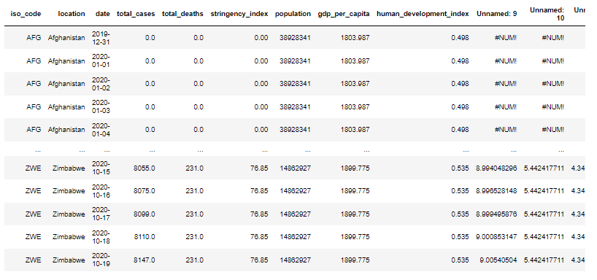
Cleaning the data
We have to clean the data from raw version to version which can be easy to perform task upon
Raw data

Slide 5
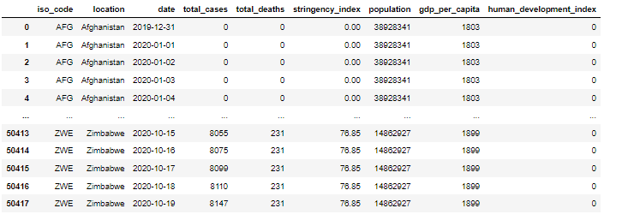
New cleaned data

Slide 6
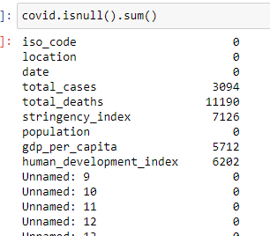
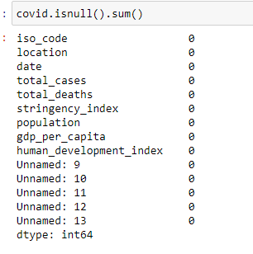
Prepare data for analysis
counting null values
Filling null values with “0” in every column having null values like this:
covid['total_cases']=covid['total_cases'].fillna(0)
covid['total_deaths']=covid['total_deaths'].fillna(0)

Slide 7
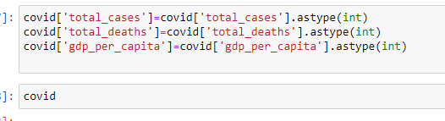

converting datatypes
WHY TO CONVERT DATA TYPES
To change non-numeric objects (such as strings) into integers or floating-point numbers as appropriate for better calculation and making statistical reports.
Dropping unwanted unnamed columns
Why :
For getting the summarize data for better analysis.

Slide 8
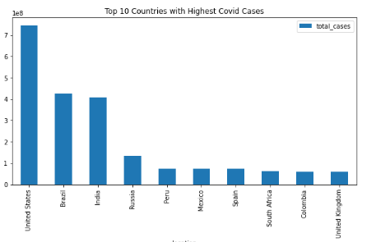
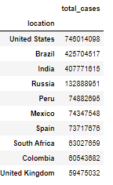
Insights
Top 10 countries with highest covid cases
This Bar chart shows us the top 10 countries with highest covid cases. From this we come to know that United States with 746014098 total cases is the country which suffers with maximum covid cases followed by Brazil , India (407771615 cases) and so on.

Slide 9
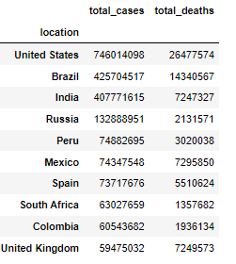
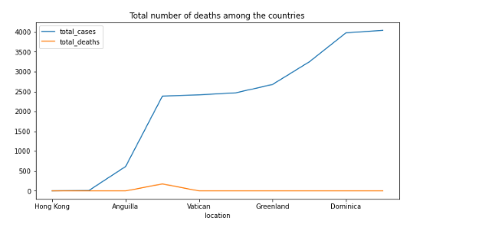

'Total number of deaths among the countries
This line chart shows us total covid cases and total deaths in respective countries . From this we can see that which country has how many covid cases and death due to covid.
Again United States(26477574) is having maximum deaths due to covid and INDIA(7247327) is at third place.

Slide 10
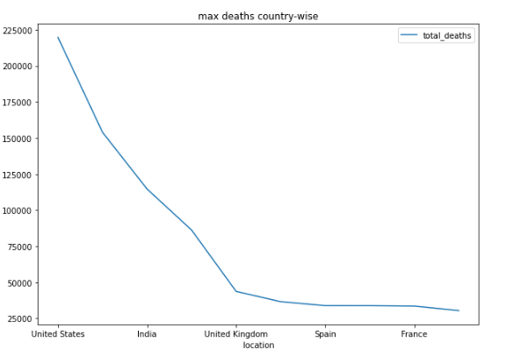
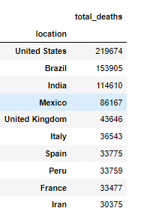
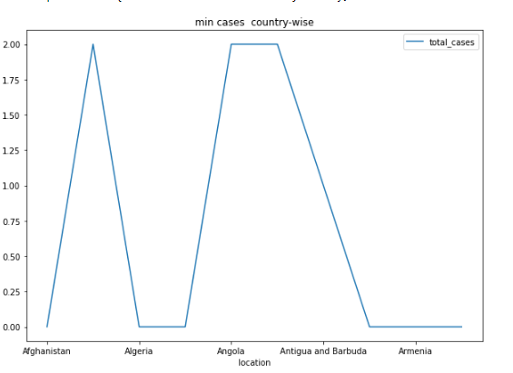
Max deaths country wise
This chart shows countries having maximum number of deaths.
Min cases country wise
This chart shows us country wise minimum number of covid cases.

Slide 11
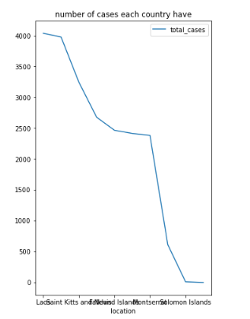
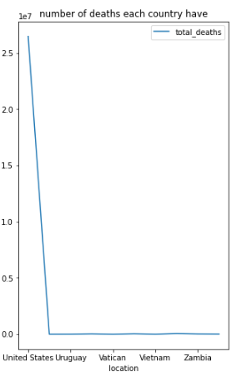
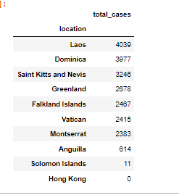
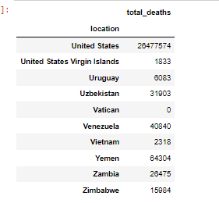
Number of deaths and cases country wise

Slide 12
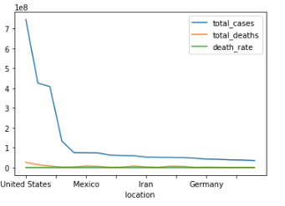
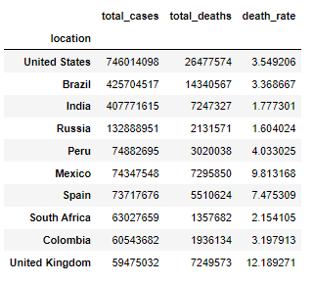
Representation of death rate on line chart

Slide 13
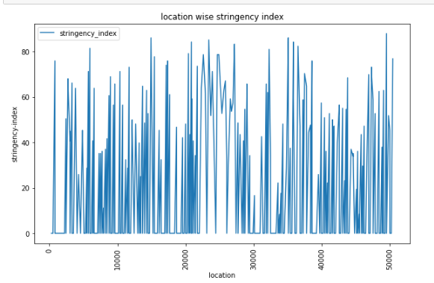
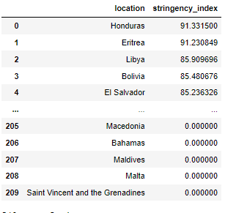
Effect of Covid-19 cases on stringency index
What is stringency index?
It is a composite measure of response indicators, including school closures, workplace closures, and travel bans. It shows how strictly countries are following these measures to control the spread of covid-19

Slide 14
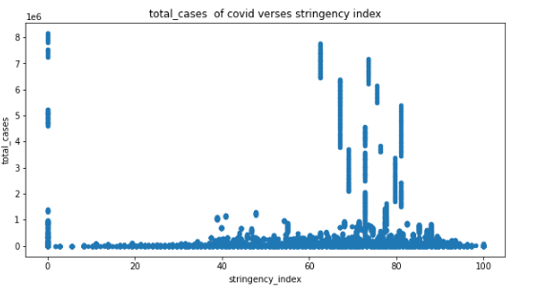
Scatter plot on stringency index

Slide 15
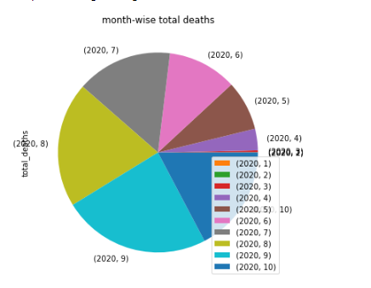
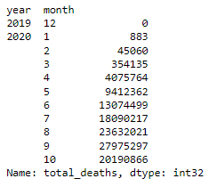
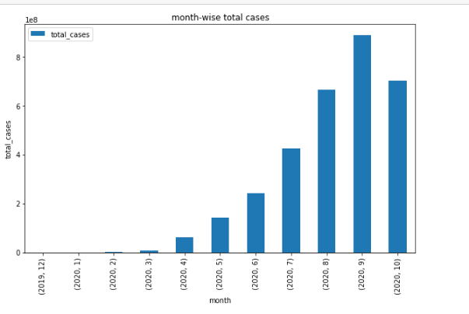
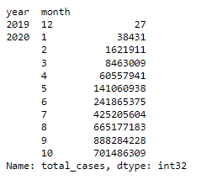
total deaths due to covid month wise
This pie chart shows total number of deaths month wise
Total cases of covid monthly

Slide 16
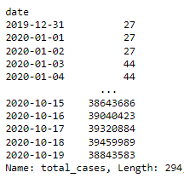
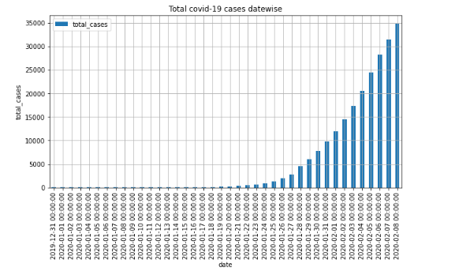
Total covid-19 cases date wise
This bar graph shows us rising cases of covid with date goes on from 2019 to end of 2020

Slide 17


Slide 18
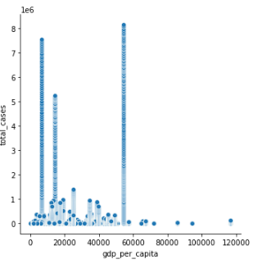

Scatter plot between total covid cases and GDP per capita
This scatter plot shows us that with rise in covid cases GDP per capita falls
Gross domestic product (GDP) is the total monetary or market value of all the finished goods and services produced within a country’s borders in a specific time period.

Slide 19
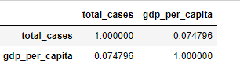
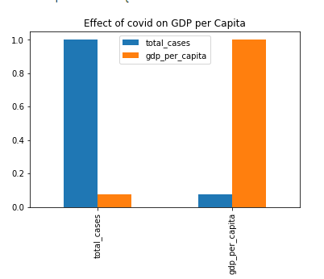
Correlation between total covid cases and GDP per capita
This bar graph shows clearly when the covid cases rises in the worldwide , this will have a adverse effect on the Economy in turn adversely affecting the GDP per Capita worldwide.
Similarly , when the cases lowers in the world , automatically the Economy of world improves , leading to the improvement of GDP per Capita of world as shown in bar graph.
Total cases is inversely proportion to GDP per
Capita of world

Slide 20
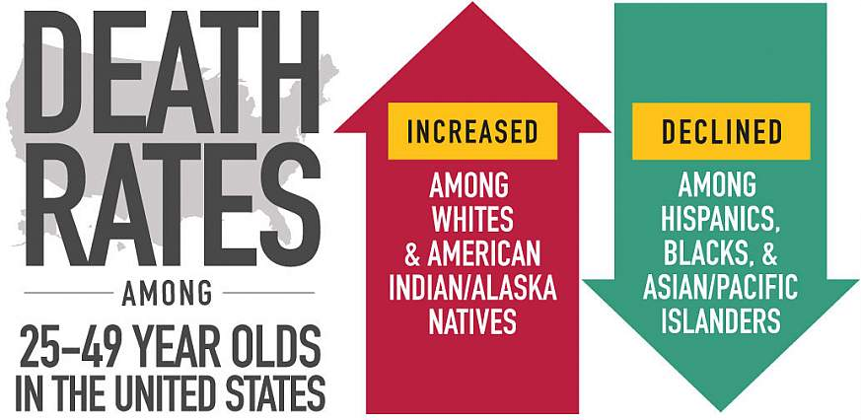
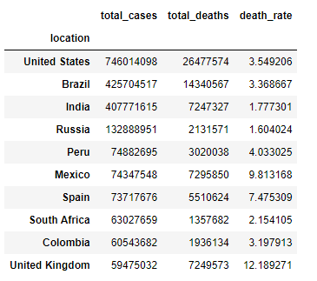
Top 10 countries with their death rates

Slide 21
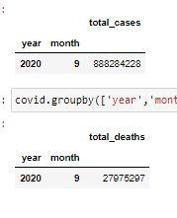
Month having maximum deaths and cases
From analyzing and aggregating the data we can infer that which month is having the cases on peak and number of deaths is maximum and we come to conclusion that in the SEPTEMBER month of 2020 is worst hit by COVID-19 virus as September is having maximum number of cases and deaths.
Maximum deaths on single day
From analyzing we also comes to know that 19th of OCTOBER is having maximum number of deaths on a single day and that too in UNITED STATES OF AMERICA.(219674)

Slide 22

COVID IN INDIA

Slide 23
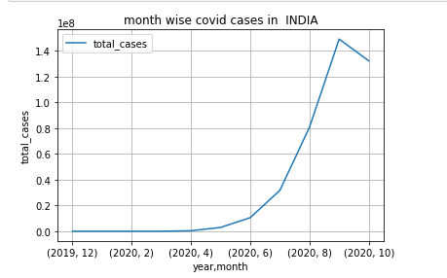
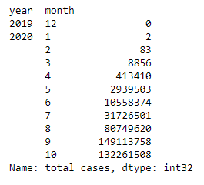
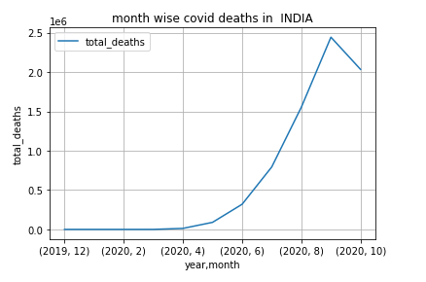
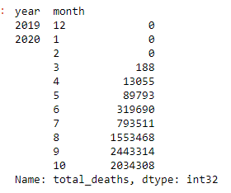
Month wise cases and deaths in INDIA
cases
deaths

Slide 24

COVID IN USA

Slide 25
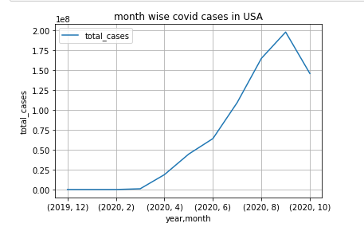
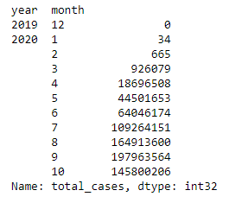
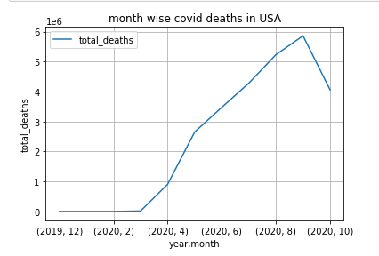
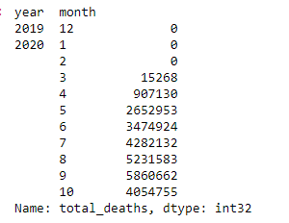
Month wise cases and deaths in usa
cases
deaths

Slide 26
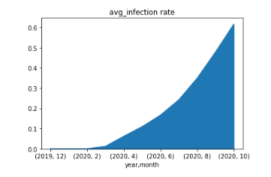
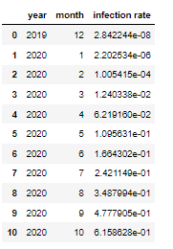
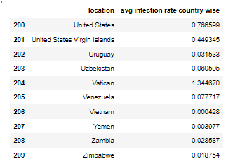
Infection rate
Infection rate = total cases of covid/population * 100
From the data analysis we comes to know that USA has the highest average of infection rate.

Slide 27




Slide 28


